Slide 1
INTEGRAL CALCULUS AND ORDINARY DIFFERENTIAL EQUATIOSNS
METHODS OF INTEGRATION

Slide 2
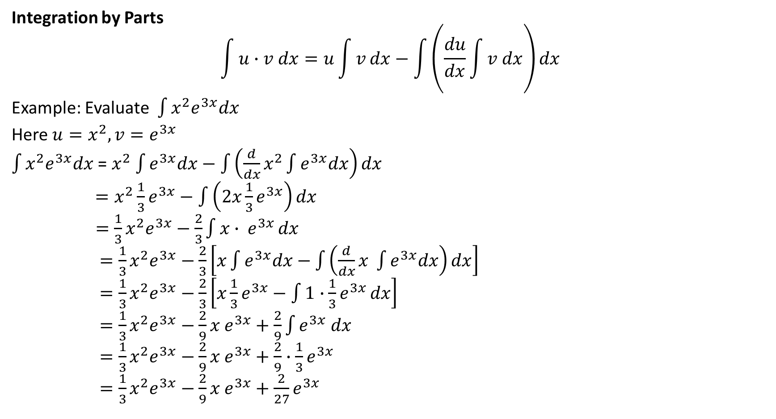
Integration by Parts
$$\int{u∙v dx=u\int{v}dx−\int{\left(\frac{du}{dx}\int{v dx}\right)dx}}$$
Example: Evaluate $\int{x^{2}e^{3x}dx}$
Here $u=x^{2}, v=e^{3x}$
$\int{x^{2}e^{3x}dx}$ = $x^{2}$ $\int{e^{3x}dx−\int{\left({\frac{d}{dx}x}^{2}\int{e^{3x}dx}\right)dx}}$
$=x^{2}\frac{1}{3}e^{3x}−$ $\int{\left(2x\frac{1}{3}e^{3x}\right)dx}$
$=\frac{1}{3}x^{2}e^{3x}−\frac{2}{3}\int{x∙ e^{3x}}dx$
$=\frac{1}{3}x^{2}e^{3x}−\frac{2}{3}\left[x\int{e^{3x}dx−\int{\left(\frac{d}{dx}x \int{e^{3x}dx}\right)dx}}\right]$
$=\frac{1}{3}x^{2}e^{3x}−\frac{2}{3}\left[x\frac{1}{3}e^{3x}−\int{1∙\frac{1}{3}e^{3x}}dx\right]$
$=\frac{1}{3}x^{2}e^{3x}−\frac{2}{9}x e^{3x}+\frac{2}{9}\int{e^{3x} dx}$
$=\frac{1}{3}x^{2}e^{3x}−\frac{2}{9}x e^{3x}+\frac{2}{9}∙\frac{1}{3}e^{3x}$
$=\frac{1}{3}x^{2}e^{3x}−\frac{2}{9}x e^{3x}+\frac{2}{27}e^{3x}$

Slide 3
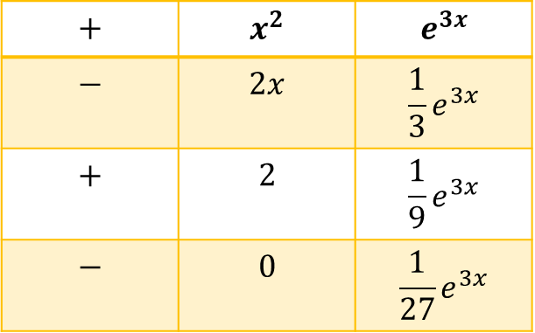

Example: Evaluate $\int{x^{2}e^{3x}dx}$
Here $u=x^{2}, v=e^{3x}$
$\int{x^{2}e^{3x}dx}$ =$+x^{2}∙\frac{1}{3}e^{3x}−2x∙\frac{1}{9}e^{3x}+2∙\frac{1}{27}e^{3x}$
$=\frac{1}{3}x^{2}e^{3x}−\frac{2}{9}x e^{3x}+\frac{2}{27}e^{3x}$
$$+$$ | $$x^{2}$$ | $$e^{3x}$$
$$−$$ | $$2x$$ | $$\frac{1}{3}e^{3x}$$
$$+$$ | $$2$$ | $$\frac{1}{9}e^{3x}$$
$$−$$ | $$0$$ | $$\frac{1}{27}e^{3x}$$

Slide 4
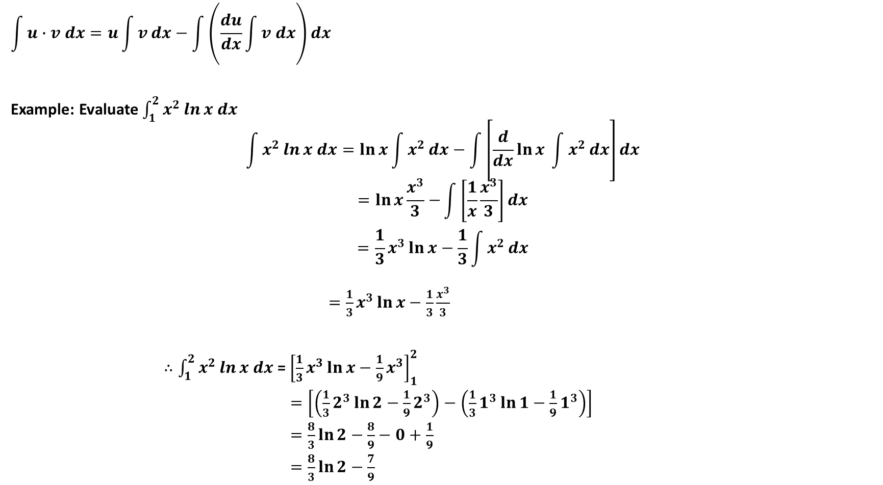
$$\int{u∙v dx=u\int{v}dx−\int{\left(\frac{du}{dx}\int{v dx}\right)dx}}$$
Example: Evaluate $\int_{1}^{2}{x^{2}\ln{x dx}}$
$$\int{x^{2}\ln{x dx=\ln{x}}\int{x^{2}}dx−\int{\left[\frac{d}{dx}\ln{x \int{x^{2}}dx}\right]dx}}$$
$$=\ln{x\frac{x^{3}}{3}−}\int{\left[\frac{1}{x}\frac{x^{3}}{3}\right]dx}$$
$$=\frac{1}{3}x^{3}\ln{x−\frac{1}{3}\int{x^{2}}dx}$$
$=\frac{1}{3}x^{3}\ln{x−\frac{1}{3}\frac{x^{3}}{3}}$
$∴\int_{1}^{2}{x^{2}\ln{x dx} }$= ${\left[\frac{1}{3}x^{3}\ln{x−\frac{1}{9}x^{3}}\right]}_{1}^{2}$
$=\left[\left(\frac{1}{3}2^{3}\ln{2−\frac{1}{9}2^{3}}\right)−\left(\frac{1}{3}1^{3}\ln{1−\frac{1}{9}1^{3}}\right)\right]$
$=\frac{8}{3}\ln{2−\frac{8}{9}−0+\frac{1}{9}}$
$=\frac{8}{3}\ln{2−\frac{7}{9}}$

Slide 5

Class Practice:
Evaluate
$\int{x^{2}e^{2x}dx}$
$\int{x^{2}\sin{2x dx}}$
$\int{x\sin{(2x+1)}}dx$
$\int_{0}^{π}{\left(2x^{2}+1\right)\cos{2x dx}}$
Home Work
Integration by parts (P-472) Example # 1, 2, 3, 4, 5
Page – 476 Ex # 3, 5, 6, 8, 17
Calculus– James Stewart - 8th edition

Slide 6
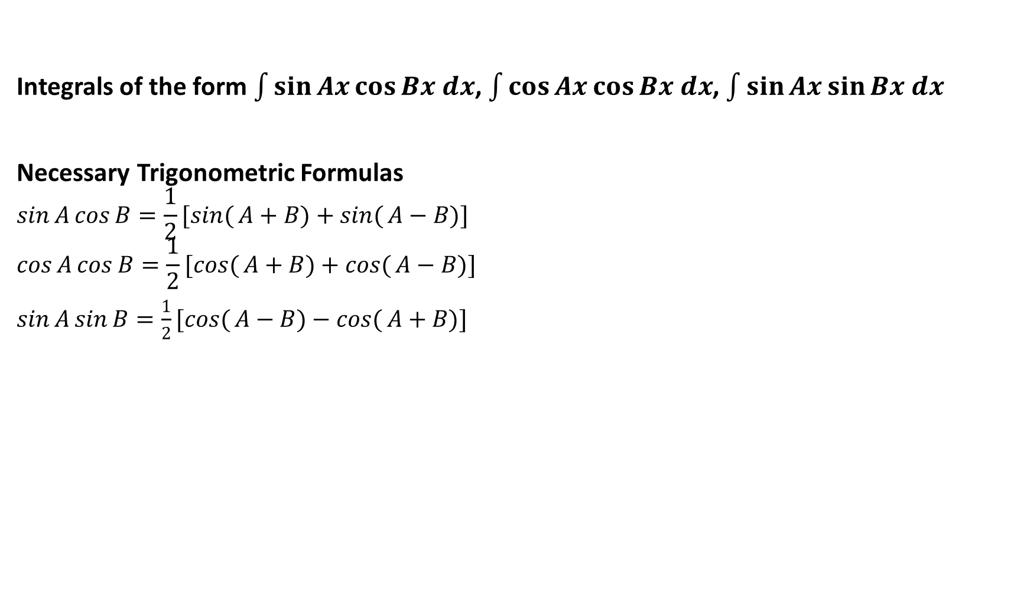
Integrals of the form $\int{\sin{Ax\cos{Bx dx}}}$, $\int{\cos{Ax\cos{Bx dx}}}$, $\int{\sin{Ax\sin{Bx dx}}}$
Necessary Trigonometric Formulas
$$\sin{A}\cos{B}=\frac{1}{2}[\sin{(}A+B)+\sin{(}A−B)]$$
$$\cos{A}\cos{B}=\frac{1}{2}[\cos{(}A+B)+\cos{(}A−B)]$$
$\sin{A}\sin{B}=\frac{1}{2}[\cos{(}A−B)−\cos{(}A+B)]$

Slide 7
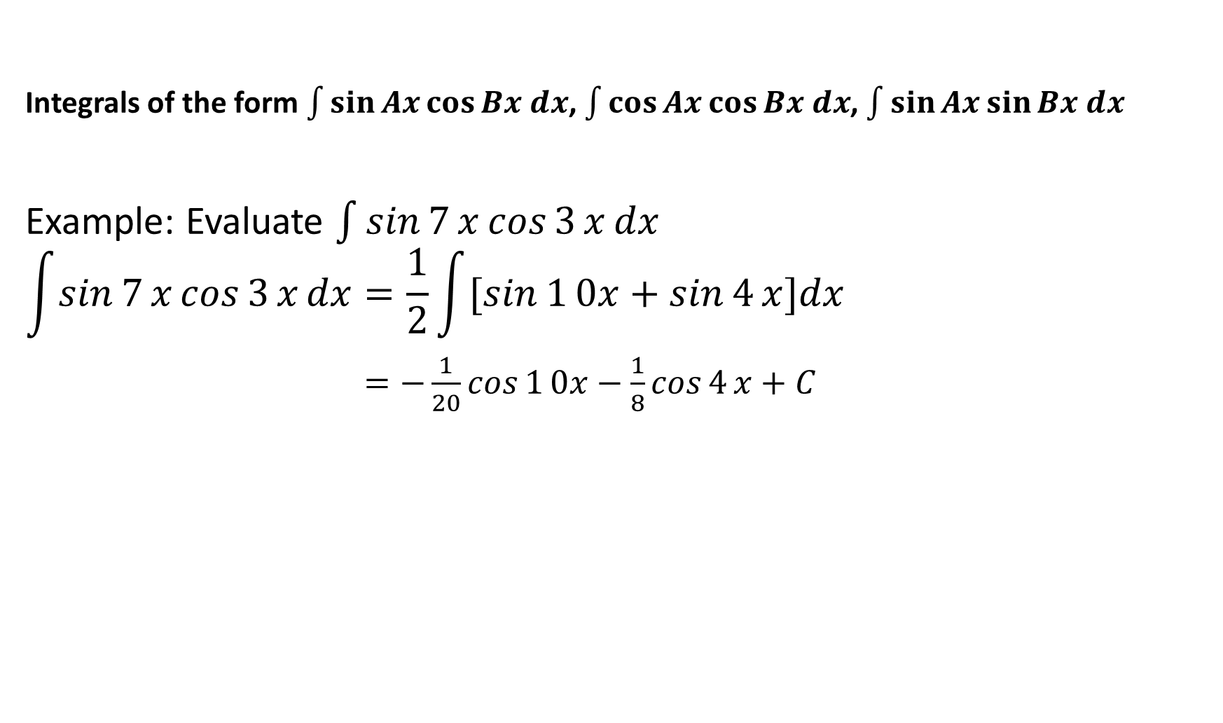
Integrals of the form $\int{\sin{Ax\cos{Bx dx}}}$, $\int{\cos{Ax\cos{Bx dx}}}$, $\int{\sin{Ax\sin{Bx dx}}}$
Example: Evaluate $\int{\sin{7}x\cos{3}x}dx$
$$\int{\sin{7}x\cos{3}x}dx=\frac{1}{2}\int{[\sin{1}0x+\sin{4}x}]dx$$
$=−\frac{1}{20}\cos{1}0x−\frac{1}{8}\cos{4}x+C$

Slide 8
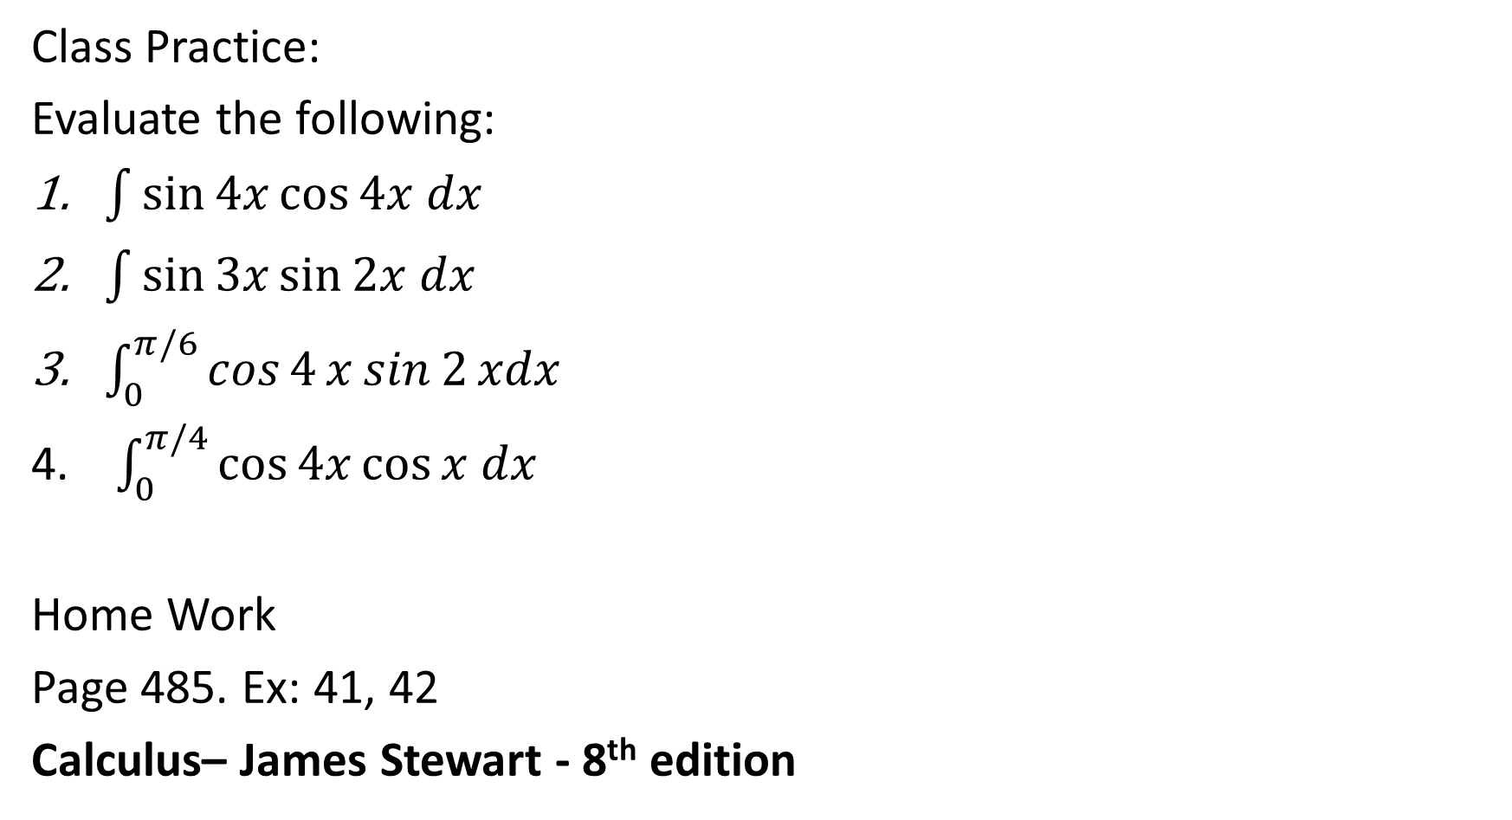
Class Practice:
Evaluate the following:
$\int{\sin{4x\cos{4x dx}}}$
$\int{\sin{3x\sin{2x dx}}}$
$\int_{0}^{π/6}{\cos{4}x\sin{2}xdx}$
$\int_{0}^{π/4}{\cos{4x\cos{x dx}}}$
Home Work
Page 485. Ex: 41, 42
Calculus– James Stewart - 8th edition

Slide 9
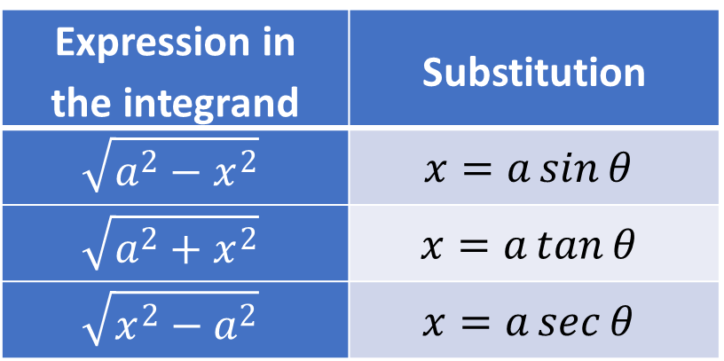
Integration of irrational functions using trigonometric substitution
Expression in the integrand | Substitution
$$\sqrt{a^{2}−x^{2}}$$ | $$x=a\sin{θ}$$
$$\sqrt{a^{2}+x^{2}}$$ | $$x=a\tan{θ}$$
$$\sqrt{x^{2}−a^{2}}$$ | $$x=a\sec{θ}$$

Slide 10
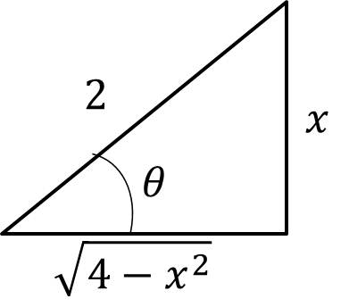
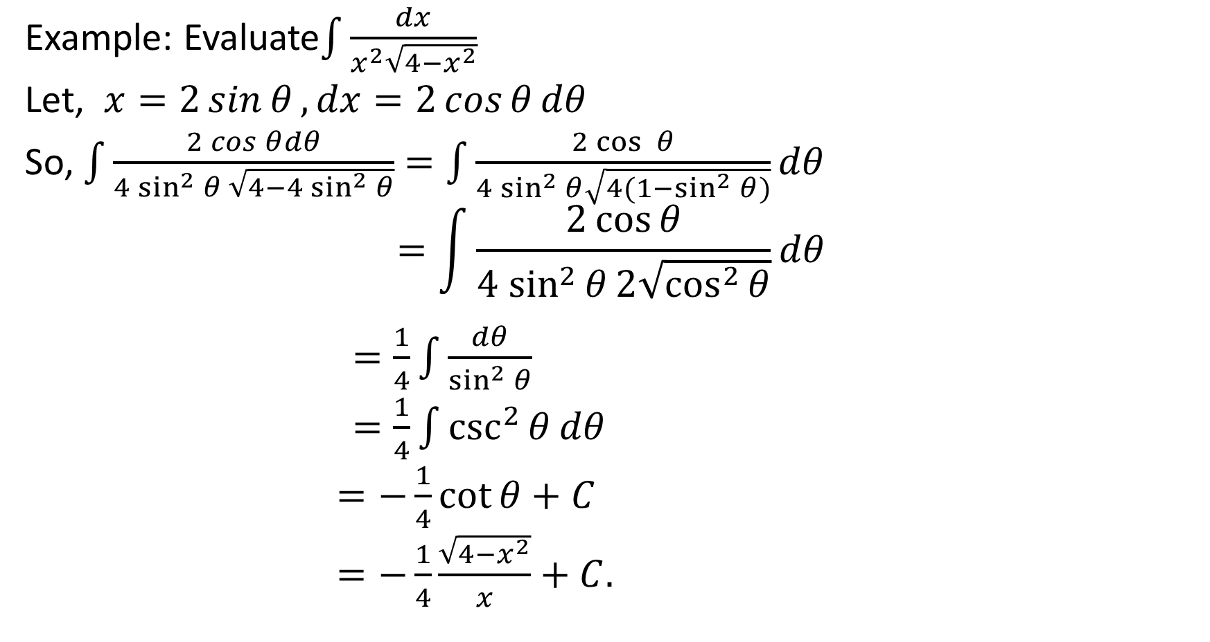
Example: Evaluate$\int{\frac{dx}{x^{2}\sqrt{4−x^{2}}}}$
Let, $x=2\sin{θ},dx=2\cos{θ}dθ$
So, $\int{\frac{2\cos{θ}dθ}{4\sin^{2}{θ} \sqrt{4−4\sin^{2}{θ}}}}$ $=\int{\frac{2\cos{ θ}}{{4 sin}^{2}{θ}\sqrt{4(1−\sin^{2}{θ)}}}dθ}$
$$=\int{\frac{2\cos{θ}}{{4 sin}^{2}{θ}2\sqrt{\cos^{2}{θ}}}dθ}$$
$=\frac{1}{4}\int{\frac{dθ}{\sin^{2}{θ}}}$
$=\frac{1}{4}\int{\csc^{2}{θ}dθ}$
$=−\frac{1}{4}\cot{θ+C}$
$=−\frac{1}{4}\frac{\sqrt{4−x^{2}}}{x}+C.$

Slide 11
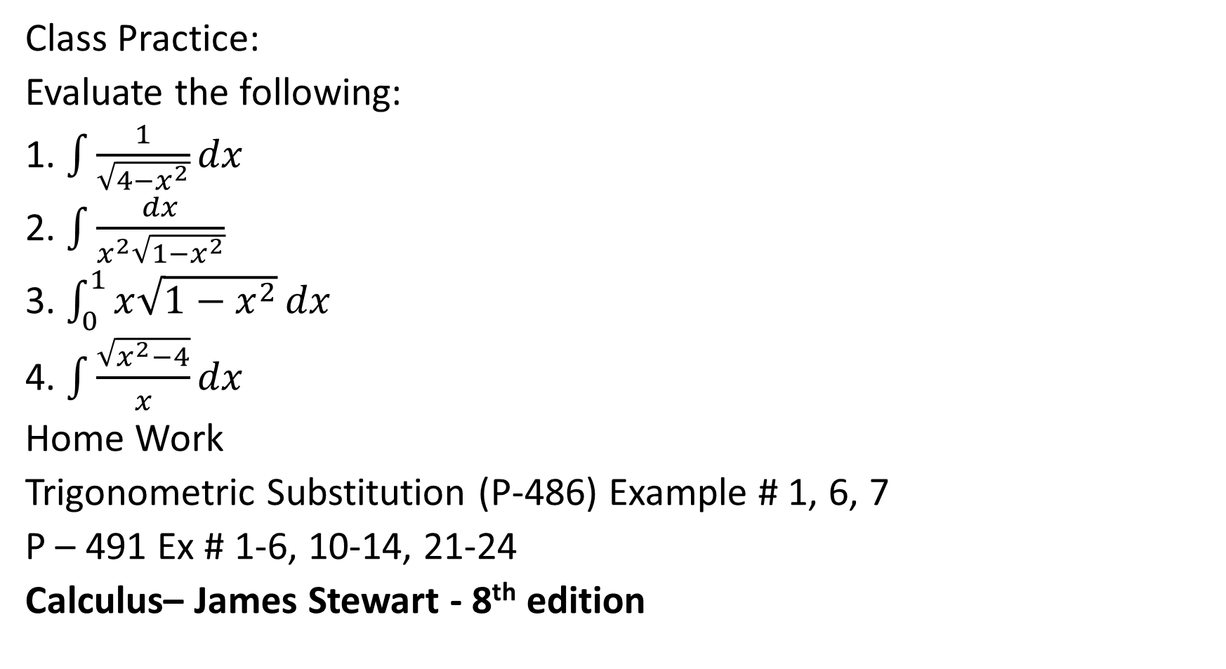
Class Practice:
Evaluate the following:
1. $\int{\frac{1}{\sqrt{4−x^{2}}}}dx$
2. $\int{\frac{dx}{x^{2}\sqrt{1−x^{2}}}}$
3. $\int_{0}^{1}{x\sqrt{1−x^{2}}}dx$
4. $\int{\frac{\sqrt{x^{2}−4}}{x}}dx$
Home Work
Trigonometric Substitution (P-486) Example # 1, 6, 7
P – 491 Ex # 1-6, 10-14, 21-24
Calculus– James Stewart - 8th edition

Slide 12

Integration of the form $\int{\sin^{m}{x}\cos^{n}{x}}dx$

Slide 13
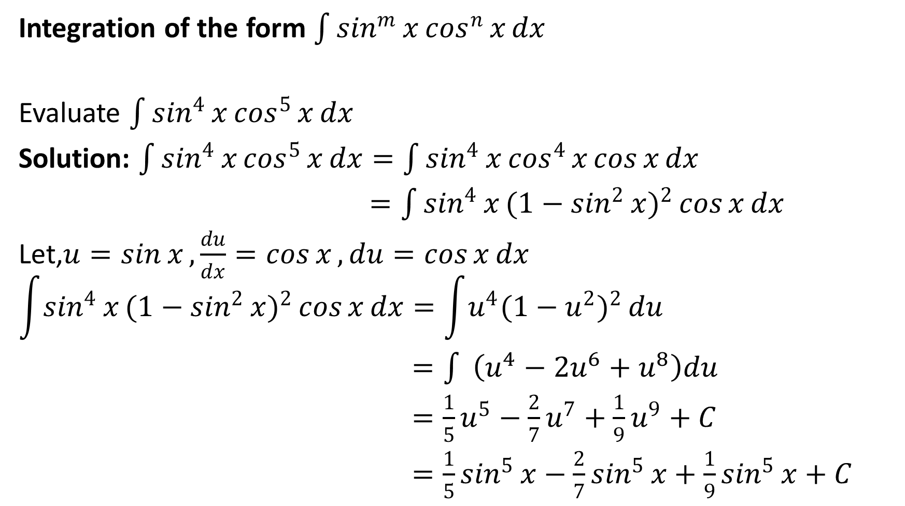
Integration of the form $\int{\sin^{m}{x}\cos^{n}{x}}dx$
Evaluate $\int{\sin^{4}{x}\cos^{5}{x}}dx$
Solution: $\int{\sin^{4}{x}\cos^{5}{x}}dx=\int{\sin^{4}{x}\cos^{4}{x}}\cos{x}dx$
$=\int{\sin^{4}{x}(1−\sin^{2}{x})^{2}}\cos{x}dx$
Let,$u=\sin{x},\frac{du}{dx}=\cos{x},du=\cos{x}dx$
$$\int{\sin^{4}{x}(1−\sin^{2}{x})^{2}}\cos{x}dx=\int{u^{4}(1−u^{2})^{2}}du$$
$=\int{ }\left(u^{4}−2u^{6}+u^{8}\right)du$
$=\frac{1}{5}u^{5}−\frac{2}{7}u^{7}+\frac{1}{9}u^{9}+C$
$=\frac{1}{5}\sin^{5}{x}−\frac{2}{7}\sin^{5}{x}+\frac{1}{9}\sin^{5}{x}+C$

Slide 14
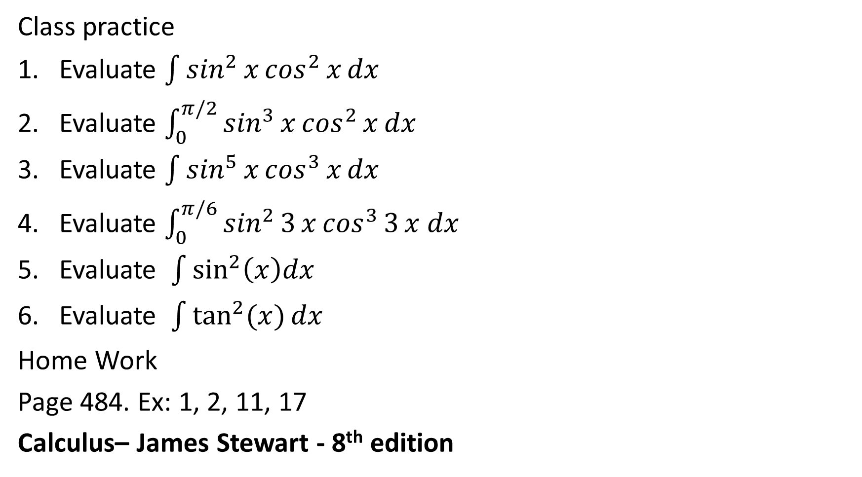
Class practice
Evaluate $\int{\sin^{2}{x}\cos^{2}{x}dx}$
Evaluate $\int_{0}^{π/2}{\sin^{3}{x}\cos^{2}{x}dx}$
Evaluate $\int{\sin^{5}{x}\cos^{3}{x}dx}$
Evaluate $\int_{0}^{π/6}{\sin^{2}{3}x\cos^{3}{3}x dx}$
5. Evaluate $\int{\sin^{2}\left(x\right)dx}$
6. Evaluate $\int{\tan^{2}{(x)}dx}$
Home Work
Page 484. Ex: 1, 2, 11, 17
Calculus– James Stewart - 8th edition

Slide 15
Partial Fraction
The Cover-up Rule - or how to make partial fractions easy
Example:

Slide 16
Partial Fraction
The Cover-up Rule - or how to make partial fractions easy
Example:

Slide 17
Partial Fraction
The Cover-up Rule - or how to make partial fractions easy
Example:

Slide 18
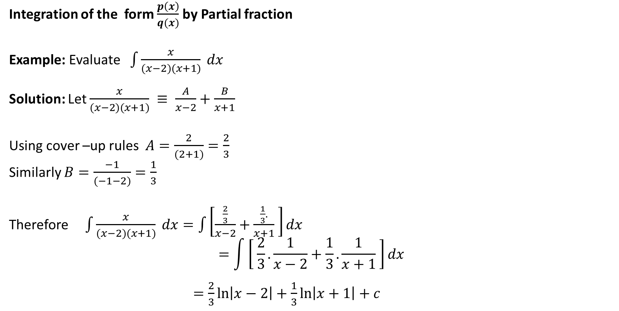
Integration of the form $\frac{p\left(x\right)}{q(x)}$by Partial fraction
Example: Evaluate $\int{\frac{x}{(x−2)(x+1)} dx}$
Solution: Let $\frac{x}{(x−2)(x+1)} ≡ \frac{A}{x−2}+\frac{B}{x+1}$
Using cover –up rules $A=\frac{2}{(2+1)}=\frac{2}{3}$
Similarly $B=\frac{−1}{(−1−2)}=\frac{1}{3}$
Therefore $\int{\frac{x}{(x−2)(x+1)} dx}=\int{\left[\frac{\frac{2}{3}}{x−2}+\frac{\frac{1}{3}.}{x+1} \right]dx}$
$$=\int{\left[ \frac{2}{3}.\frac{1}{x−2}+\frac{1}{3}.\frac{1}{x+1} \right]dx}$$
$=\frac{2}{3}\ln\left|x−2\right|+\frac{1}{3}\ln\left|x+1\right|+c$

Slide 19
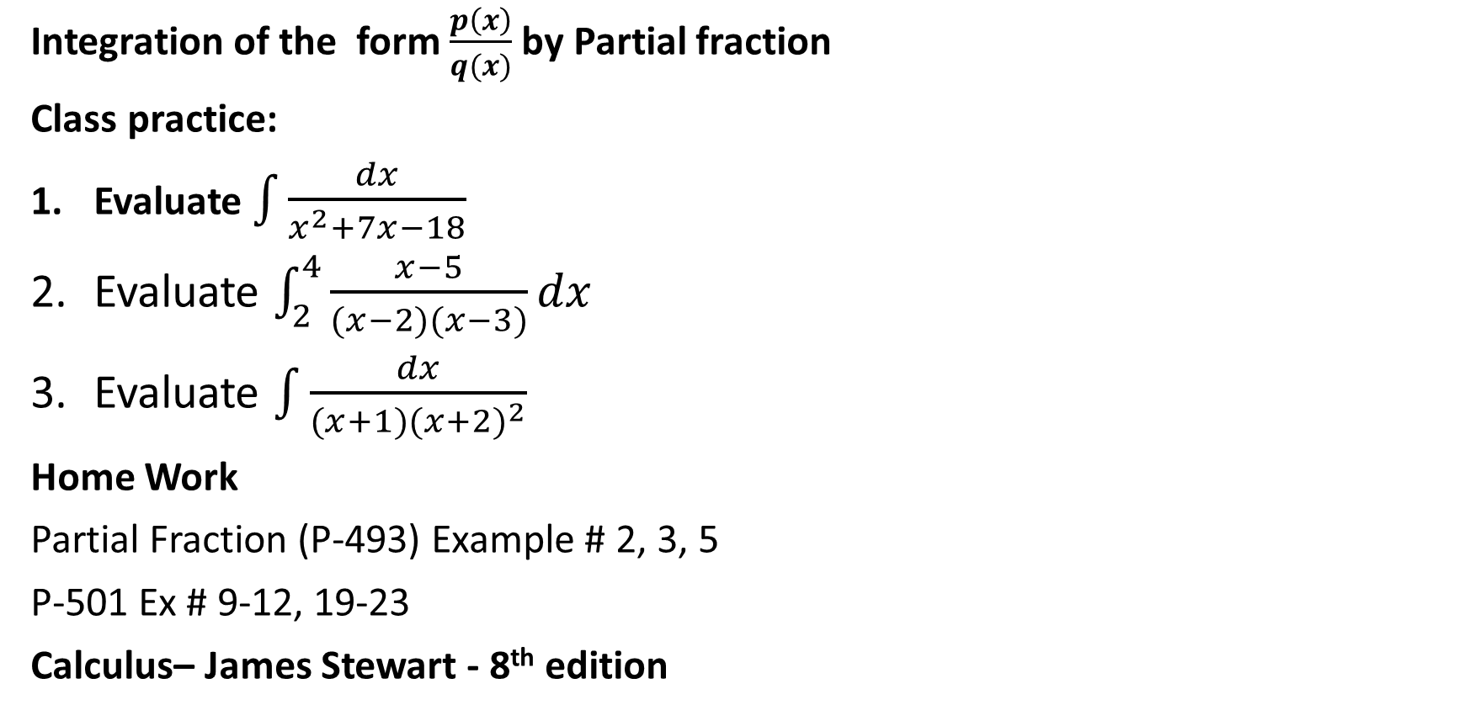
Integration of the form $\frac{p\left(x\right)}{q(x)}$by Partial fraction
Class practice:
Evaluate $\int{\frac{dx}{x^{2}+7x−18}}$
Evaluate $\int_{2}^{4}{\frac{x−5}{(x−2)(x−3)}dx}$
Evaluate $\int{\frac{dx}{(x+1)(x+2)^{2}}}$
Home Work
Partial Fraction (P-493) Example # 2, 3, 5
P-501 Ex # 9-12, 19-23
Calculus– James Stewart - 8th edition

Slide 20
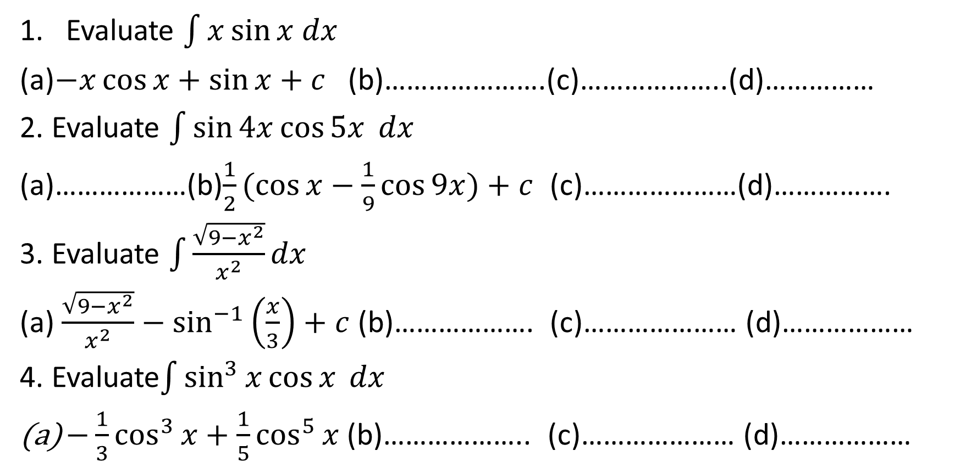
Sample MCQ
Evaluate $\int{x\sin{x dx}}$
(a)$−x\cos{x+\sin{x+c }}$ (b)………………….(c)………………..(d)……………
2. Evaluate $\int{\sin{4x}\cos{5x} dx}$
(a)………………(b)$\frac{1}{2}(\cos{x}−\frac{1}{9}\cos{9x)+c}$ (c)…………………(d)…………….
3. Evaluate $\int{\frac{\sqrt{9−x^{2}}}{x^{2}}dx}$
(a) $\frac{\sqrt{9−x^{2}}}{x^{2}}−\sin^{−1}\left(\frac{x}{3}\right)+c$(b)………………. (c)………………… (d)………………
4. Evaluate$\int{\sin^{3}{x}\cos{x} dx}$
$−\frac{1}{3}\cos^{3}{x+\frac{1}{5}\cos^{5}{x}}$ (b)……………….. (c)………………… (d)………………

